Slide 1
Chapter 01 Database Systems
Department of Computer Science

Slide 2
Chapter 1
Database Systems

Slide 3
Learning Objectives
In this chapter, we will learn:
The difference between data and information
What a database is, the various types of databases, and why they are valuable assets for decision making
The importance of database design
How modern databases evolved from file systems

Slide 4
Learning Objectives
In this chapter, we will learn:
About flaws in file system data management
The main components of the database system
The main functions of a database management system (DBMS)

Slide 5
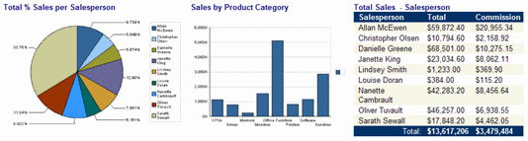
Data versus Information
Data
Information
Raw facts
Have not yet been processed to reveal their meaning to the end user
e.g. numbers, characters, graphics, images, audio, video
Building blocks of information
Data management
Generation, storage, and retrieval of data
Data is what you store in database.
Produced by processing raw data to reveal its meaning
Requires context
e.g. Total sale for month June, Total students at Bahria Karachi campus
Bedrock of knowledge
Should be accurate, relevant, and timely to enable good decision making
Information is what you retrieve from a database.
Data in Context
Information –
Pie Chart, Bar Graph
Table
Notes:
Transforming Data into information
By
Querying
Sorting
Reporting

Slide 6
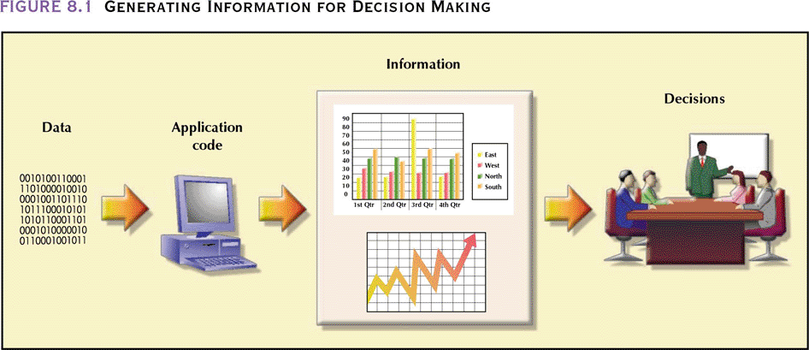
Database: … for Decision Making
(DBMS)
Database Systems: Design, Implementation, & Management: Rob & Coronel

Slide 7
Introducing the Database
Shared, integrated computer structure that stores a collection of:
End-user data - Raw facts of interest to end user
Metadata: Data about data, which the end-user data are integrated and managed
Describe data characteristics and relationships
Database management system (DBMS)
Collection of programs
Manages the database structure
Controls access to data stored in the database
Metadata

Slide 8
Role of the DBMS
Intermediary between the user and the database
Enables data to be shared
Presents the end user with an integrated view of the data
Receives and translates application requests into operations required to fulfill the requests
Hides database’s internal complexity from the application programs and users

Slide 9
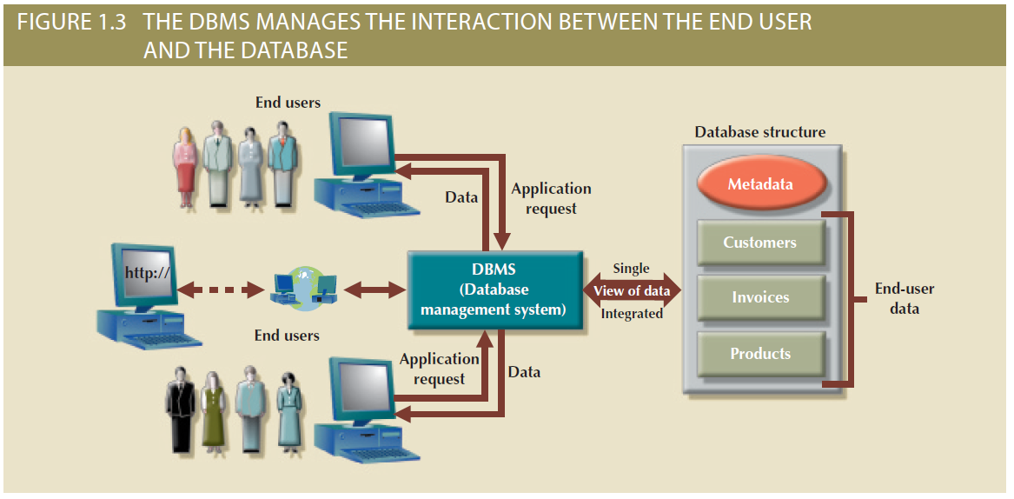
Figure 1.3 - The DBMS Manages the Interaction between the End User and the Database

Slide 10
Advantages of the DBMS
Better data integration and less data inconsistency
Data inconsistency: Different versions of the same data appear in different places
Increased end-user productivity
Improved:
Data sharing
Data security
Data access
Decision making
Data quality: Accuracy, validity, and timeliness of data

Slide 11
Types of Databases
Single-user database: Supports one user at a time
Desktop database: Runs on PC
Multiuser database: Supports multiple users at the same time
Workgroup databases: Supports a small number of users or a specific department
Enterprise database: Supports many users across many departments

Slide 12
Types of Databases
Centralized database: Data is located at a single site
Distributed database: Data is distributed across different sites
Cloud database: Created and maintained using cloud data services that provide defined performance measures for the database

Slide 13
Types of Databases
General-purpose databases: Contains a wide variety of data used in multiple disciplines
Discipline-specific databases: Contains data focused on specific subject areas
Operational database: Designed to support a company’s day-to-day operations

Slide 14
Types of Databases
Analytical database: Stores historical data and business metrics used exclusively for tactical or strategic decision making
Data warehouse: Stores data in a format optimized for decision support
Online analytical processing (OLAP)
Tools for retrieving, processing, and modeling data from the data warehouse
Business intelligence: Captures and processes business data to generate information that support decision making

Slide 15
Types of Databases
Unstructured data: It exists in their original state
Structured data: It results from formatting
Structure is applied based on type of processing to be performed
Semistructured data: Processed to some extent
Extensible Markup Language (XML)
Represents data elements in textual format

Slide 16
Database Design
Focuses on the design of the database structure that will be used to store and manage end-user data
Well-designed database
Facilitates data management
Generates accurate and valuable information
Poorly designed database causes difficult-to-trace errors

Slide 17
Evolution of File System Data Processing
Manual File Systems
Accomplished through a system of file folders and filing cabinets
Computerized File Systems
Data processing (DP) specialist: Created a computer-based system that would track data and produce required reports
File System Redux: Modern End-User Productivity Tools
Includes spreadsheet programs such as Microsoft Excel

Slide 18
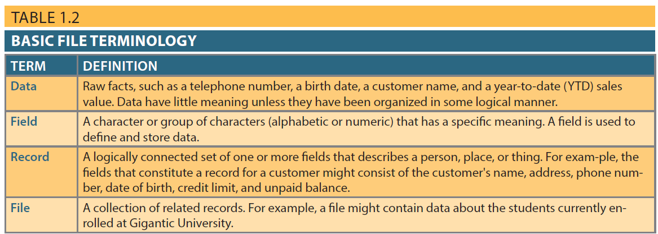
Table 1.2 - Basic File Terminology

Slide 19
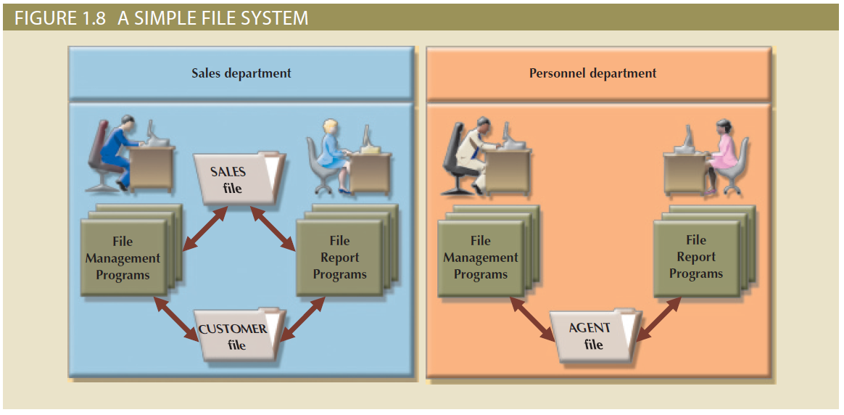
Figure 1.8 - A Simple File System

Slide 20
Problems with File System Data Processing
Lengthy development times
Difficulty of getting quick answers
Complex system administration
Lack of security and limited data sharing
Extensive programming

Slide 21
Structural and Data Dependence
Structural dependence: Access to a file is dependent on its own structure
All file system programs are modified to conform to a new file structure
Structural independence: File structure is changed without affecting the application’s ability to access the data

Slide 22
Structural and Data Dependence
Data dependence
Data access changes when data storage characteristics change
Data independence
Data storage characteristics is changed without affecting the program’s ability to access the data
Practical significance of data dependence is difference between logical and physical format
Notes:
Like storing the data in magnetic tapes or hard drives etc

Slide 23
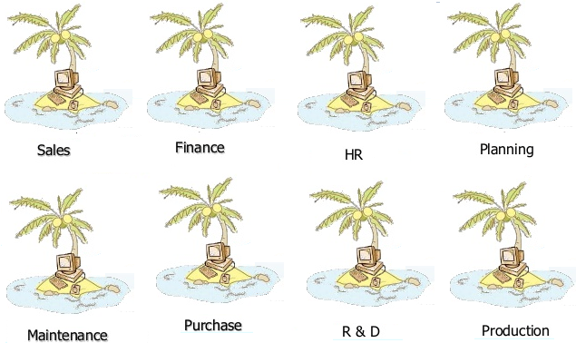
Data Redundancy
Unnecessarily storing same data at different places
Islands of information: Scattered data locations
Increases the probability of having different versions of the same data

Slide 24
Data Redundancy Implications
Poor data security
Data inconsistency
Increased likelihood of data-entry errors when complex entries are made in different files
Data anomaly: Develops when not all of the required changes in the redundant data are made successfully

Slide 25
Types of Data Anomaly
Update Anomalies
Insertion Anomalies
Deletion Anomalies
An Update Anomaly exists when one or more instances of duplicated data is updated, but not all.
An insertion anomaly is the inability to add data to the database due to absence of other data.
A Delete Anomaly exists when certain attributes are lost because of the deletion of other attributes.
Notes:
An insertion anomaly is the inability to add data to the database due to absence of other data. For example, assume Student_Group is defined so that null values are not allowed. If a new employee is hired but not immediately assigned to a Student_Group then this employee could not be entered into the database. This results in database inconsistencies due to omission.
Delete Anomalies. A Delete Anomaly exists when certain attributes are lost because of the deletion of other attributes. For example, consider what happens if Student S30 is the last student to leave the course - All information about the course is lost.

Slide 26
Database Systems
Logically related data stored in a single logical data repository
Physically distributed among multiple storage facilities
DBMS eliminates most of file system’s problems
Current generation DBMS software:
Stores data structures, relationships between structures, and access paths
Defines, stores, and manages all access paths and components

Slide 27
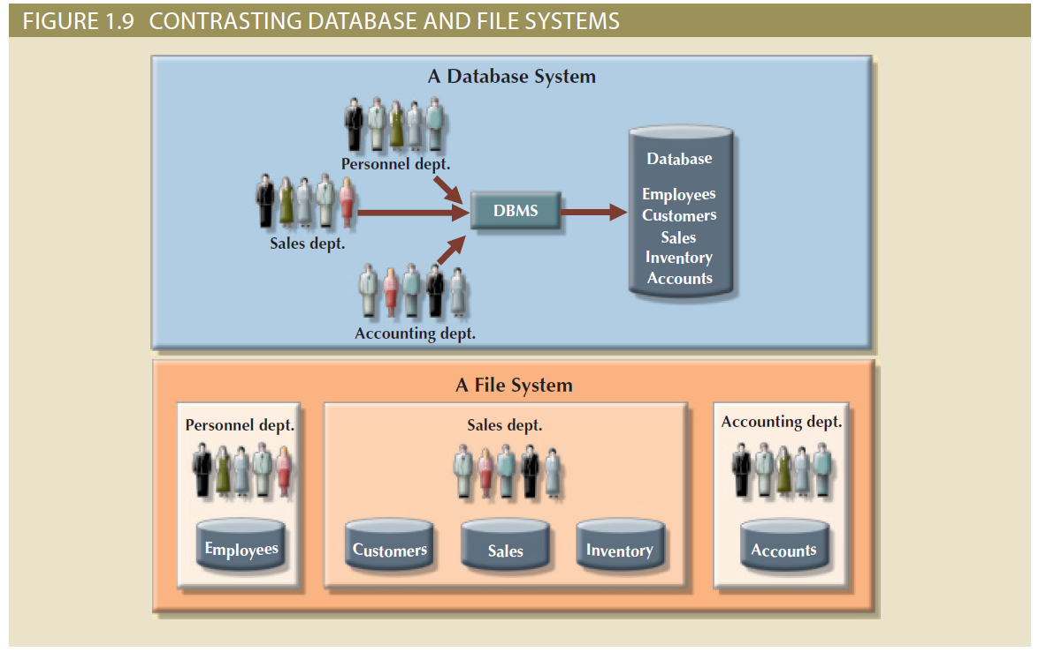
Figure 1.9 - Contrasting Database and File Systems

Slide 28
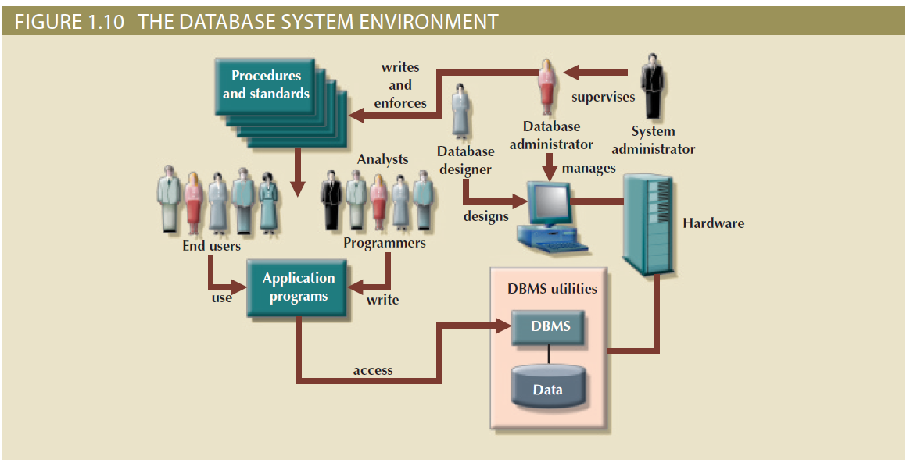
Figure 1.10 - The Database System Environment

Slide 29
DBMS Functions
Data dictionary management
Data dictionary: Stores definitions of the data elements and their relationships
Data storage management
Performance tuning: Ensures efficient performance of the database in terms of storage and access speed
Data transformation and presentation
Transforms entered data to conform to required data structures
Security management
Enforces user security and data privacy

Slide 30
DBMS Functions
Multiuser access control
Sophisticated algorithms ensure that multiple users can access the database concurrently without compromising its integrity
Backup and recovery management
Enables recovery of the database after a failure
Data integrity management
Minimizes redundancy and maximizes consistency

Slide 31
DBMS Functions
Database access languages and application programming interfaces
Query language: Lets the user specify what must be done without having to specify how
Structured Query Language (SQL): De facto query language and data access standard supported by the majority of DBMS vendors
Database communication interfaces
Accept end-user requests via multiple, different network environments

Slide 32
Disadvantages of Database Systems
Increased costs
Management complexity
Maintaining currency
Vendor dependence
Frequent upgrade/replacement cycles

Slide 33
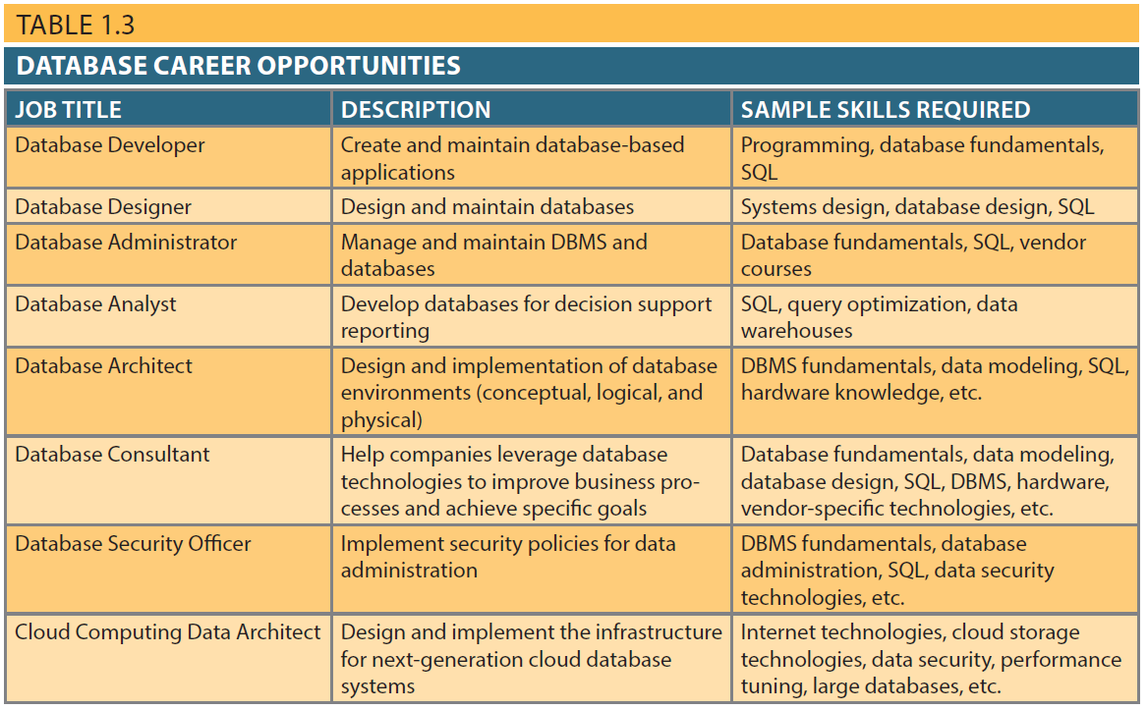
Table 1.3 - Database Career Opportunities
31

